Slide 1
(CYBERSECURITY)

Slide 2
CyberSecurity (Seritifikasi Internasional)
Atep Aulia Rahman, ST.,M.Kom.,MOS.,CCNA.,MTCNA.,MTCRE.,MAT
Consultant IT Academy
Lecturer and IT Network Specialist
087821721396

Slide 3
KRITERIA PENILAIAN
1. Knowlage (60 %)
Komponen Evaluasi Bobot
- Tugas –Tugas (online) 20 %
- Ujian Tengah Semester 30 %
- Ujian Akhir Semester 50 %
Jumlah 100 %
2. Attitude (40 %)
Komponen Evaluasi Bobot
- Kehadiran 80 %
- Sikap 20 %
Jumlah 100 %

Slide 4
Aturan Matakuliah Security
Tugas dan Kehadiran 100 %
Selalu Oncam (Jika sycronous) + Point
Berpakain Sopan
Telat 15 menit, mahasiswa tidak bisa mengikuti pembelajaran
Jika dari semua kriteria diatas lolos mahasiswa sudah mempunyai nilai B untuk Nilai semester....

Slide 5


Benefit Sertifikasi Internasional

Slide 6
Benefits of Certifications
Differentiation and Credibility at Company and in Market:
Increase skills
Improve chances of being hired
Increase value to employers
***Global Knowledge/Tech Republic IT Skills and Salary Report, 2012

Slide 7

Certifications Are a Strong Priority for Evaluating Candidates
86%
86% of IT hiring managers consider certifications a strong priority for evaluating candidates.
*CompTIA Employer Perception of IT Training and Certification, Feb. 7, 2011
Notes:
Certifications add value to professionals. In today’s challenging economy, especially, they provide differentiation in the market, improve chances of being hired, and provide premium in compensation.
Slides following show premiums gained for U.S. salaries.

Slide 8
Certifications Help Holders Qualify for Positions
IT decision makers rate certifications second only to four-year degrees in qualifying for positions.*
Importance to Qualify for Positions
Certification
Four-year degree
Type of Qualification
*Study commissioned by Cisco and conducted by Forrester Research, June 2008.
Notes:
Certifications add value to professionals. In today’s challenging economy, especially, they provide differentiation in the market, improve chances of being hired, and provide premium in compensation.
Slides following show premiums gained for U.S. salaries.

Slide 9
Certifications Improve Chance of Being Hired
Hiring managers from 700 IT companies view certifications as at least as important as a bachelors degree.*
Importance
Bachelor’s degree
Certification
Type of Qualification
*The Journal of Information Technology Education, Volume 7, 2008
Notes:
Certifications add value to professionals. In today’s challenging economy, especially, they provide differentiation in the market, improve chances of being hired, and provide premium in compensation.
Slides following show premiums gained for U.S. salaries.

Slide 10

Why Cisco ?

Slide 11

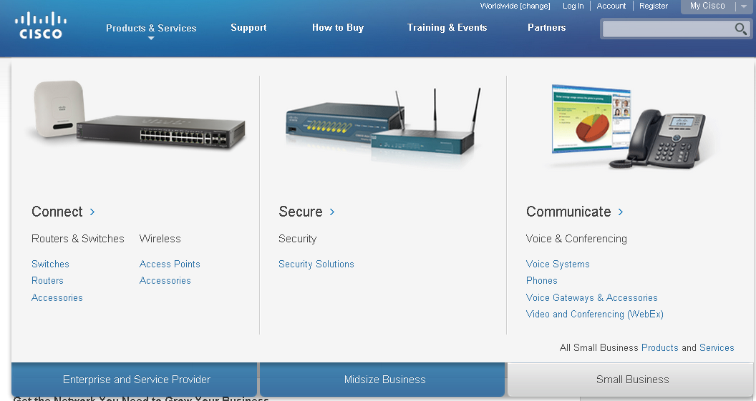

Product Line

Slide 12
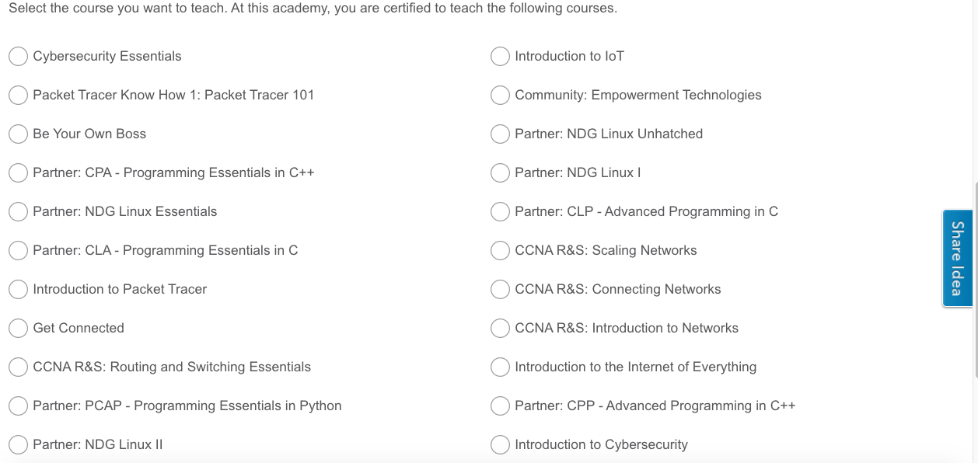

Slide 13
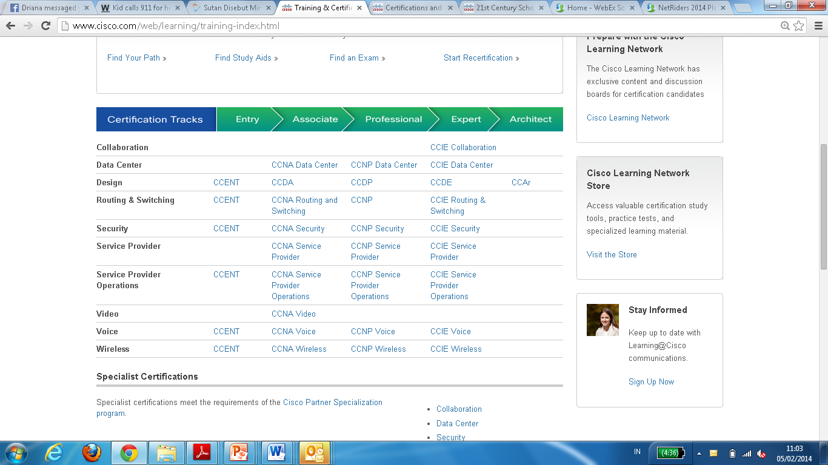
Cisco Certifications

Slide 14
Curricula Portofolio
ROUTE: Implementing IP Routing
SWITCH: Implementing IP Switched Networks
TSHOOT: Troubleshooting and Maintaining IP Networks
Introductions to Networking
Routing & Switching Essentials
Scalling Networks
Connecting Network
Network Professional
CCNA Security
Network Specialist
CCNP
IT Essentials: PC Hardware and Software
CCNA Security
Network Associate
CCNA R&S
Network Technician
IT Essentials
IT Technician
PACKET TRACER
Student Networking Knowledge and Skills
Notes:
NOTE: this is a build slide
Our current portfolio consists of 13 courses
IT Essentials: PC Hardware and Software —provides an overview of how the internal components of a computer work The course covers laptops and portable devices, assembling/disassembling PC components, wireless connectivity, security, safety and environmental issues associated with installing, configuring and troubleshooting and a PC.
CCNA Discovery (4 courses) —provides an introduction to networking. It teaches networking based on application and helps students develop foundational routing, switching, and WAN knowledge and experience, which can be applied toward entry-level careers in networking for small and medium-sized businesses.
CCNA Exploration (4 courses) —provides an introduction to networking. It teaches networking based on technology. It covers routing, switching, and WAN protocols and theory at deeper levels to help students succeed in networking-related degree programs and a range of professions.
CCNA Security –helps students develop a comprehensive understanding of network security concepts, and gain the knowledge and skills needed to earn the Cisco CCNA Security certification and become entry-level security specialists.
CCNP (3 courses) —the CCNP curriculum focuses on the advanced routing, secure wide area access, multilayer switching, and networking management skills required to implement and maintain converged enterprise networks.
Cisco Packet Tracer — Provides a realistic simulation and visualization learning environment that supplements classroom equipment. Cisco Packet Tracer is a foundational teaching tool for CCNA Discovery and CCNA Exploration, withPacket Tracer activities embedded in the course content. Both curricula include embedded e-doing, which applies the principle that people learn best by interacting with computer-based activities. Interactive learning promotes the exploration of networking concepts and experimentation with tools such as Packet Tracer and Flash-based activities to help students develop a greater understanding of networking technologies. Packet Tracer activities are also available for IT Essentials and CCNA Security.
14

Slide 15
Alignment to Industry Certifications
Courses Align with Globally Recognized Certifications
CompTIA A+
CCNA
CCNA Security
CCNP
IT Essentials
CCNA R & S
CCNA Security
CCNP
Student Networking Knowledge and Skills
Notes:
All of our curricula help prepare students for industry recognized certifications:
IT Essentials: PC Hardware and Software — CompTIA A+ certification
CCNA Discovery (first 2 courses) — CCENT certification
CCNA Discovery (4 courses) — CCNA certification
CCNA Exploration (4 courses) — CCNA certification
CCNA Security - CCNA Security certification
CCNP (3 courses) — CCNP certification
15

Slide 16
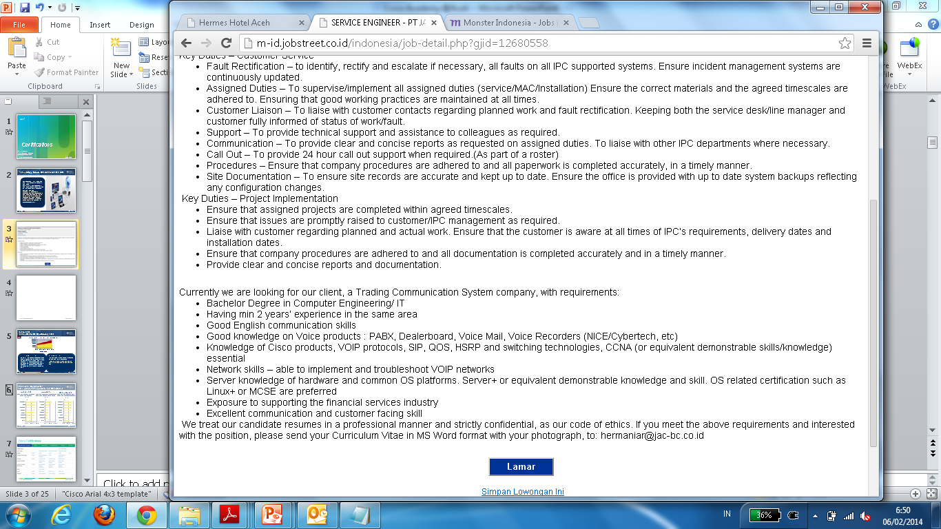
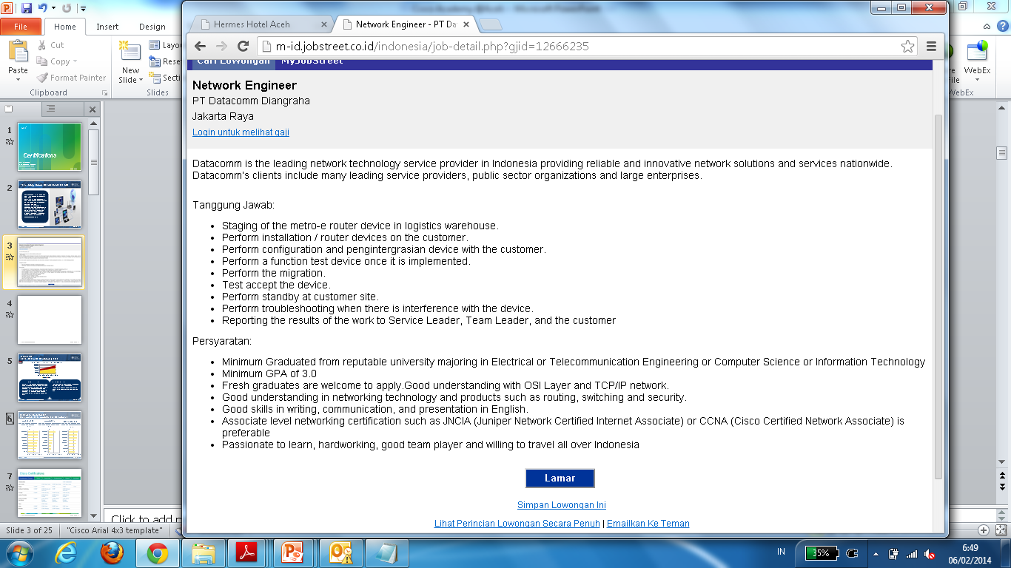
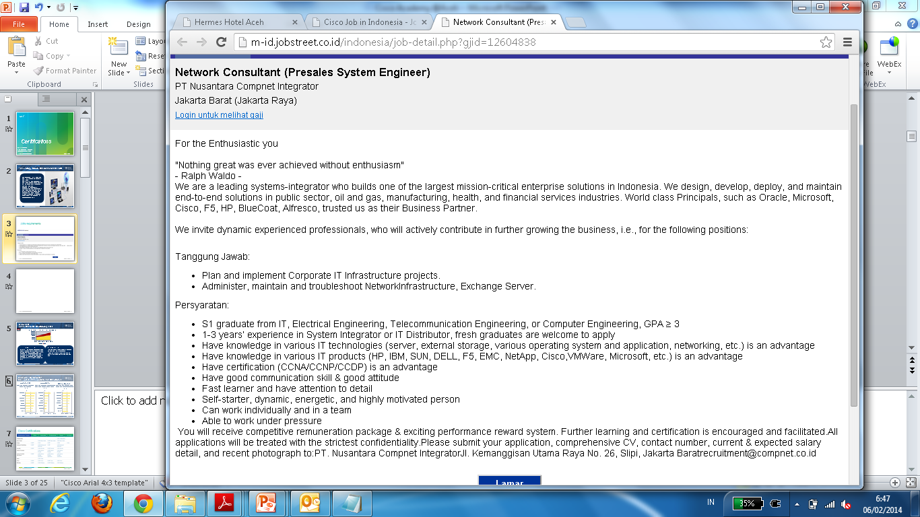
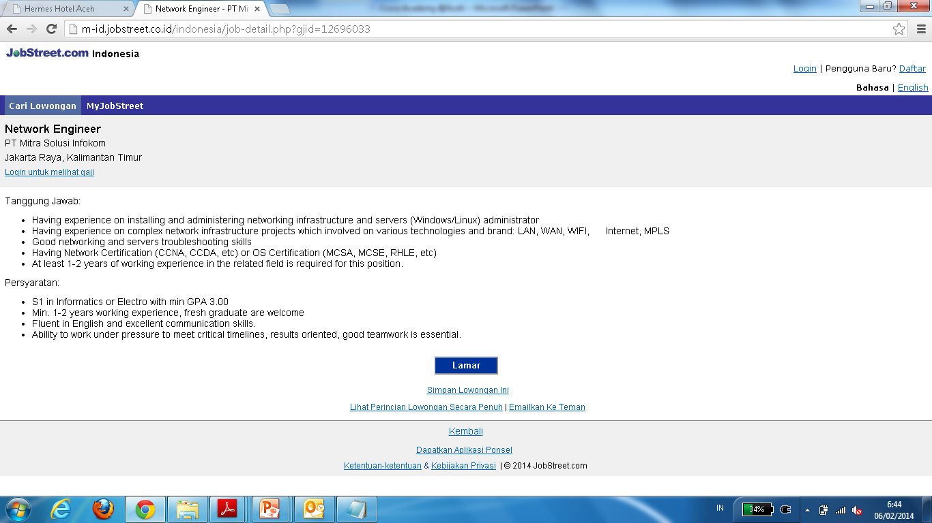
Jobs requirements
Notes:
16

Slide 17
TERIMA KASIH

